Slide 1
5.1 | React Deep dive
Understanding React from examples

Slide 2
Jargon we’ll learn today
Jsx, class vs className, static vs dynamic websites,
State, components, re-rendering

Slide 3

Why do you need React?
For static websites, you don’t!

Slide 4
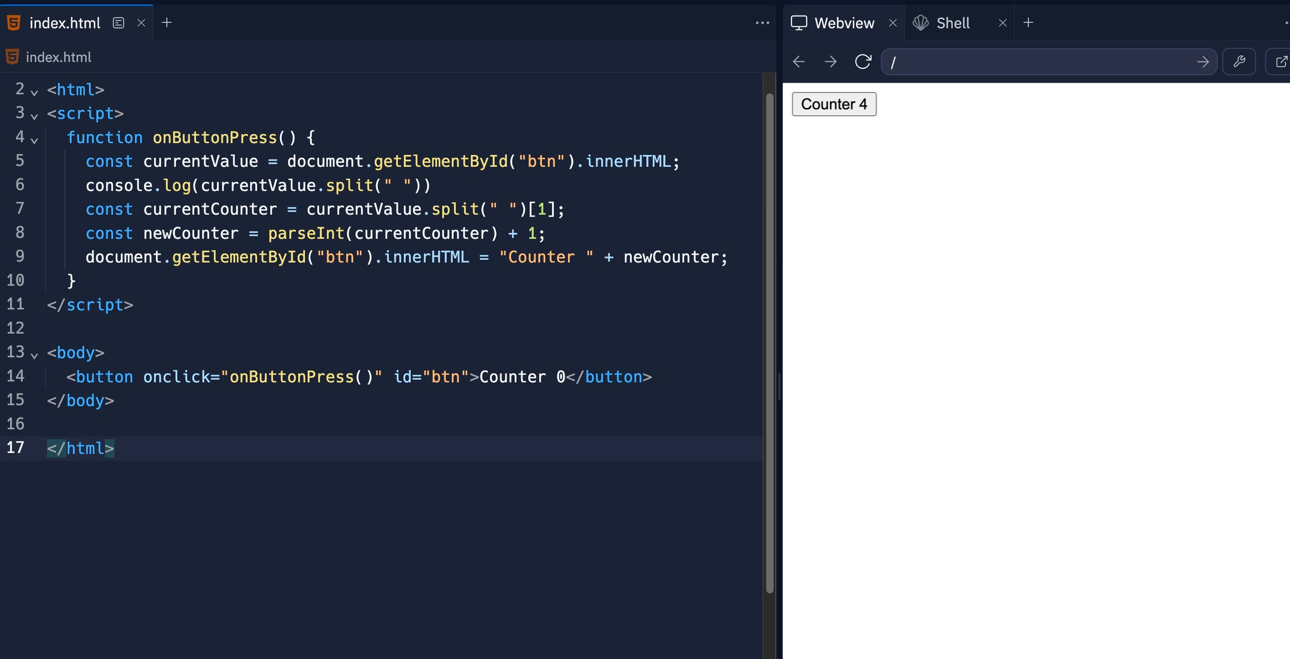
Why do you need React?
For dynamic websites, these libraries make it easier to do DOM manipulation

Slide 5
React is just an easier way to write normal HTML/CSS/JS It’s a new syntax, that under the hood gets converted to
HTML/CSS/JS
React
npm run build
HTML/CSS/JS

Slide 6
Just how ChatGPT is an easier way to write code,
React is an easier way to write HTML/CSS
ChatGPT
React
npm run build
HTML/CSS/JS

Slide 7
Why React?
People realised it’s harder to do DOM manipulation the conventional way There were libraries that came into the picture that made it slightly easy, but still for a very big app it’s very hard (JQuery) Eventually, VueJS/React created a new syntax to do frontends Under the hood, the react compiler convert your code to HTML/CSS/JS

Slide 8
Let’s look at a simple example
Problem with this approach 1.Too much code you have to write as the developer 2.As your app scales (todo app for eg), this gets
harder and harder.
https://gist.github.com/hkirat/0c22122a9485d4d592b92677570e6be8

Slide 9
Some react jargon

Slide 10
Some react jargon
To create a react app, you usually need to worry about two things

Slide 11
Some react jargon
To create a react app, you usually need to worry about two things
State
Components

Slide 12
Some react jargon
To create a react app, you usually need to worry about two things
Creators of frontend frameworks realised that all websites can effectively be divided into two parts
State
Components

Slide 13
State/Components/Re-rendering
An object that represents the current state of the app
It represents the dynamic things in your app (things that change) For example, the value of the counter
State

Slide 14
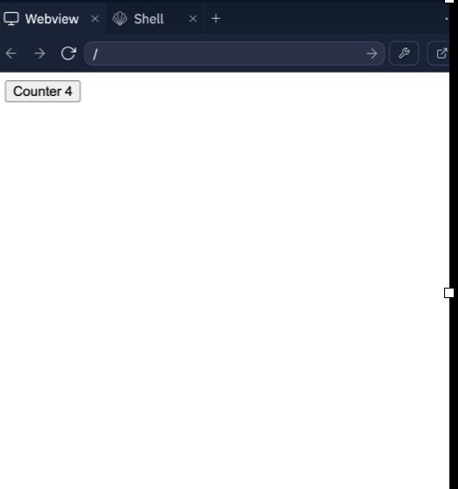
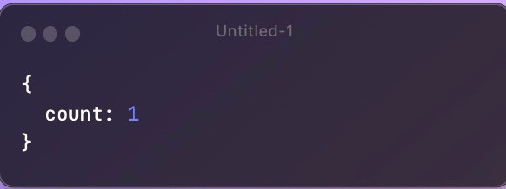
State/Components/Re-rendering
For the counter app, it could look something like this -

Slide 15
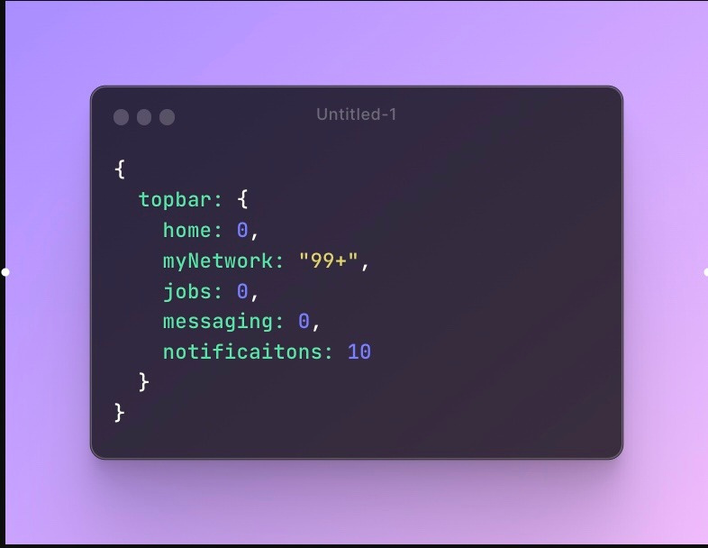

State/Components/Re-rendering
For the LinkedIn Topbar, it could be something like this -

Slide 16
State/Components/Re-rendering
How a DOM element should render, given a state
It is a re-usable, dynamic, HTML snippet that changes given the state
Components

Slide 17
State/Components/Re-rendering
This button is a component It takes the state (currentCount) as an input
And is supposed to render accordingly

Slide 18
State/Components/Re-rendering

Slide 19

State/Components/Re-rendering
State
Component

Slide 20
State/Components/Re-rendering
State
Component
A state change triggers a re-render A re-render represents the actual DOM being manipulated
when the state changes

Slide 21
State/Components/Re-rendering
State
Component
A state change triggers a re-render A re-render represents the actual DOM being manipulated
11
11
when the state changes

Slide 22
State/Components/Re-rendering
You usually have to deﬁne all your components once And then all you have to do is update the state of your app, React takes care of re-rendering your app

Slide 23
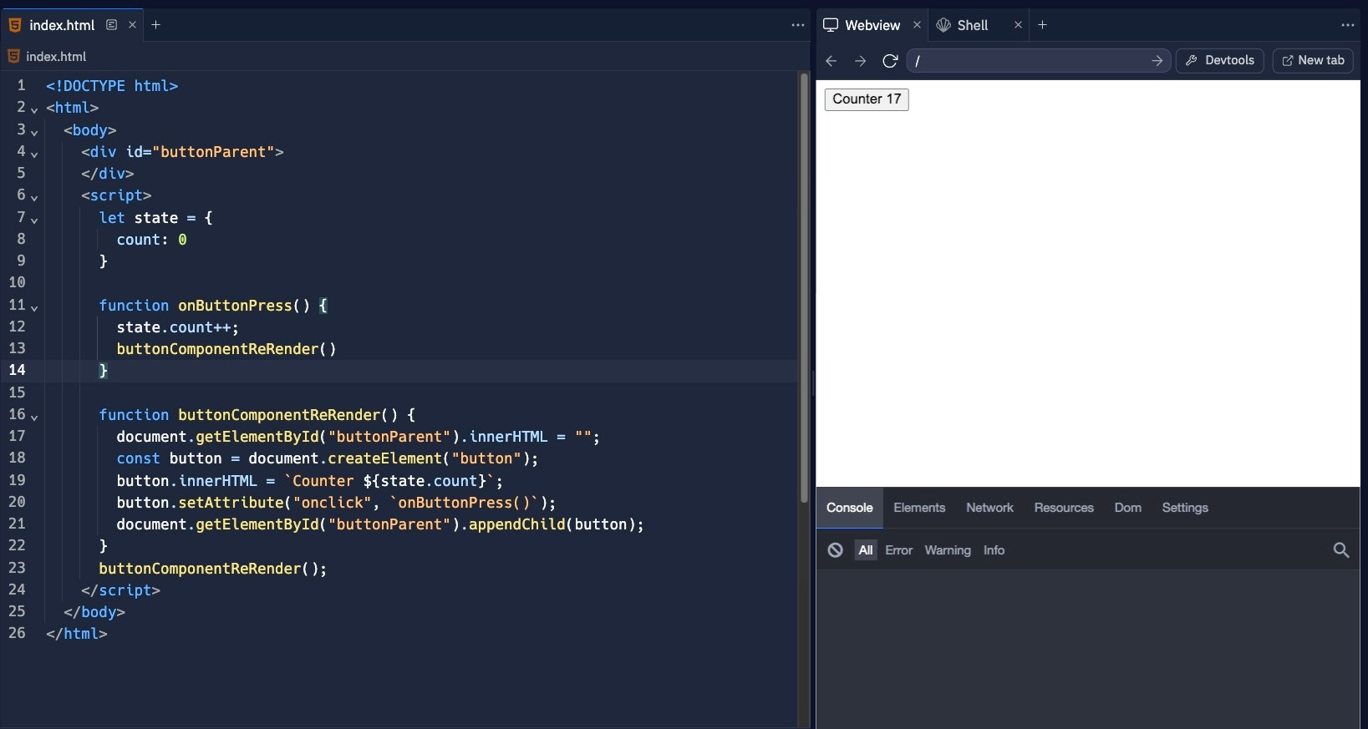
Let’s create a counter app using state/components
https://gist.github.com/hkirat/c3d98735cec445e718b08f972dda7101

Slide 24
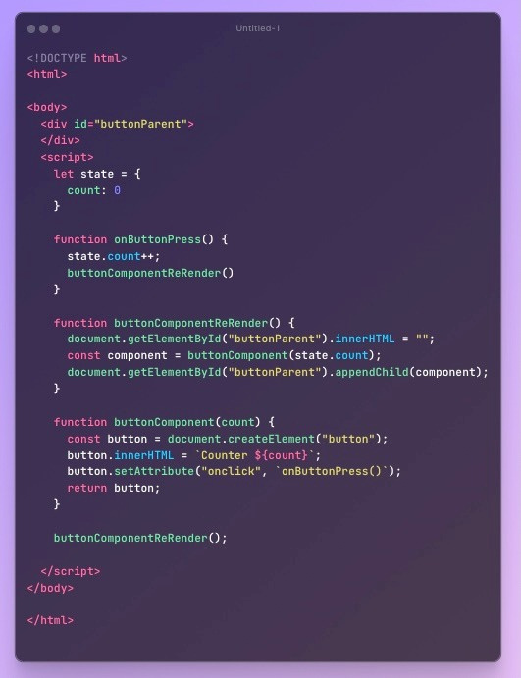
Let’s create a counter app using state/components
1. State initialisation

Slide 25
Let’s create a counter app using state/components
2. Deﬁning the button component

Slide 26
Let’s create a counter app using state/components
The react library

Slide 27
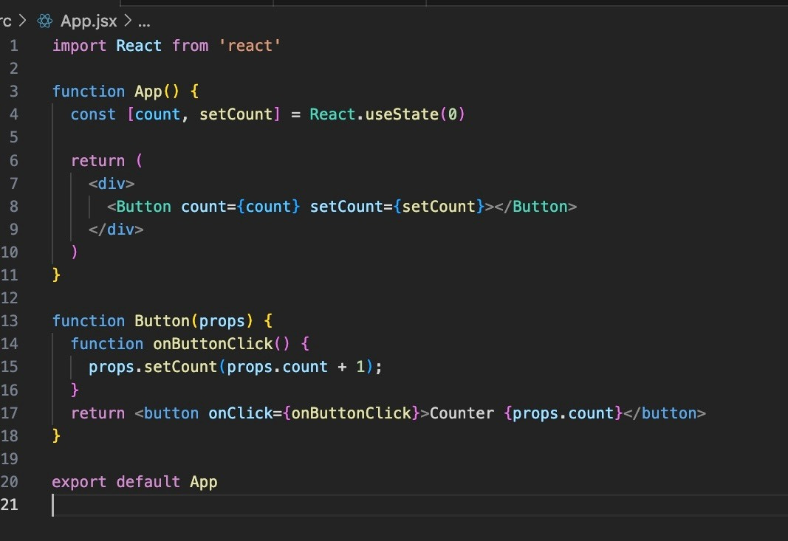
The equivalent code in React looks like this

Slide 28
The equivalent code in React looks like this
Lets start small, and then build up to this app

Slide 29
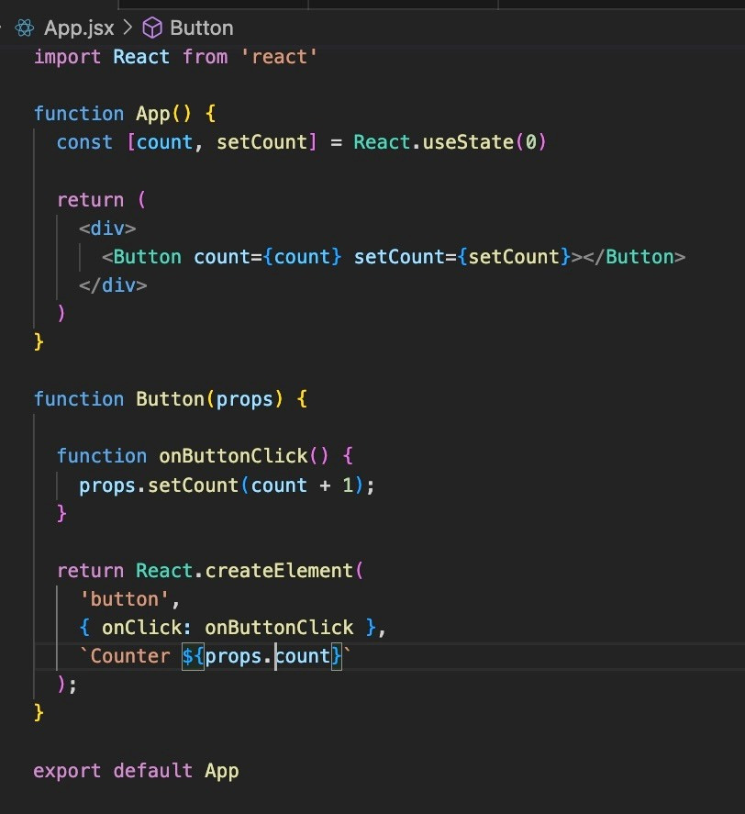
The equivalent code in React looks like this
Lets start with a simple button component
https://gist.github.com/hkirat/db15d13b42c906269b3114efb96d820f

Slide 30
The equivalent code in React looks like this
Deﬁning Button component
https://gist.github.com/hkirat/8801c2cfad70853decd0ad1759d4e63c

Slide 31
The equivalent code in React looks like this
Deﬁning Button component
https://gist.github.com/hkirat/8801c2cfad70853decd0ad1759d4e63c

Slide 32
The equivalent code in React looks like this
Triggering re-render
https://gist.github.com/hkirat/8801c2cfad70853decd0ad1759d4e63c

Slide 33
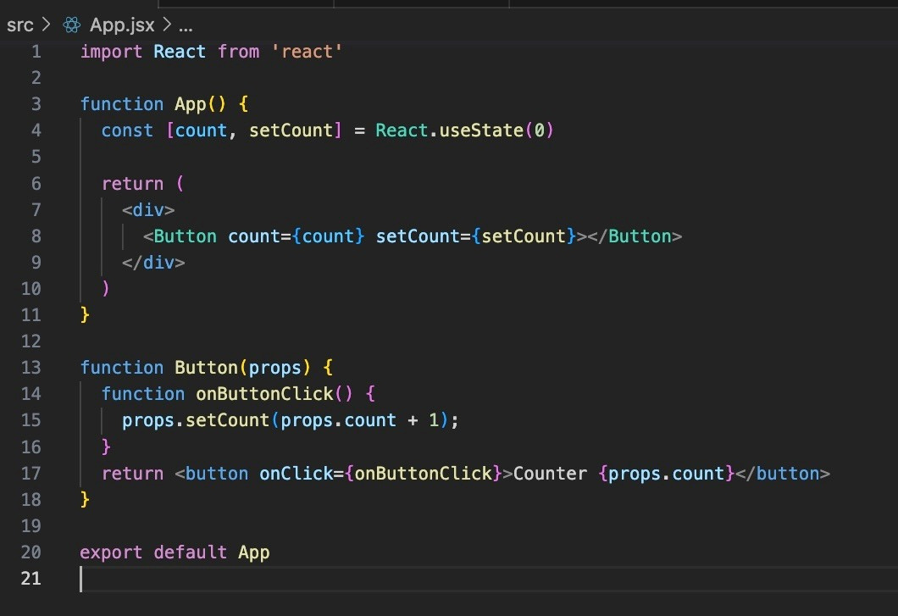
The equivalent code in React looks like this
Jsx syntax is a cleaner way to wrote components
https://gist.github.com/hkirat/8801c2cfad70853decd0ad1759d4e63c

Slide 34
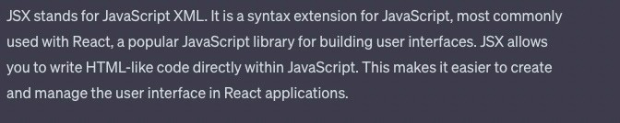
The equivalent code in React looks like this
What Is jsx
https://gist.github.com/hkirat/dcc85803a20639826bf8f64c6be24a31

